Slide 1

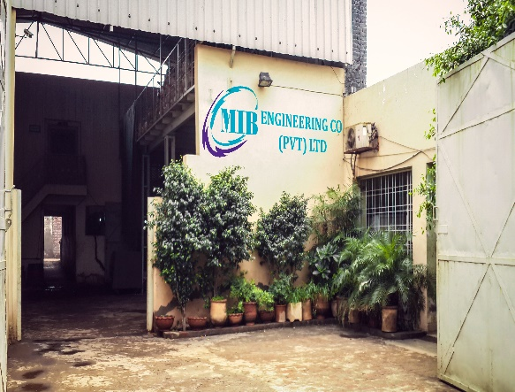

MIB ENGINEERING CO. (PRIVATE) LIMITED
MISSION STATEMENT
manufacturing quality with innovation
Email: mib@cyber.net.pk
Email: mibecpl@gmail.com
To meet customer needs of today with precision quality, latest technology, team work and attain greater cost-effectiveness in a progressive, innovative and challenging environment by adopting best business practices and ethics.
To provide an enriching, rewarding and environment friendly work experience to our employees in an achievement-based, high-performance culture.
SALAMATPURA, NEAR ATTOCK PETROL PUMP, G.T. ROAD, DAROGHWALA, LAHORE 54920, PAKISTAN
MIB ENGINEERING CO. (PRIVATE) LIMITED
Tel: +92-42-36543466
Tel: +92-42-36540037

Slide 2
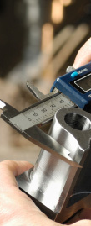
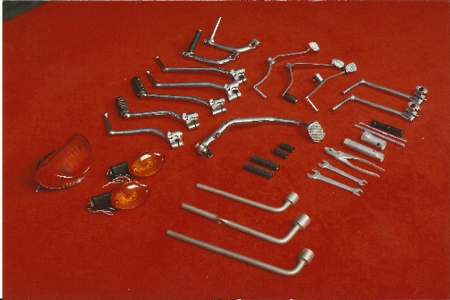
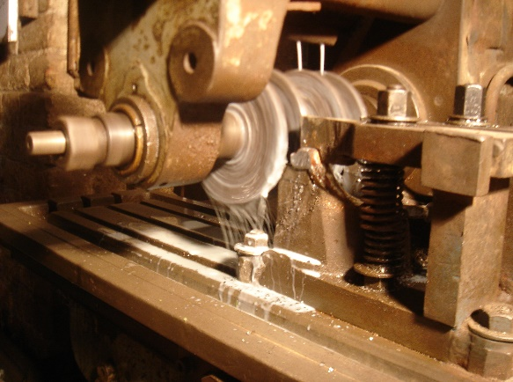
MIB Engineering Co. (PVT) Ltd (Formerly M. Iqbal Brothers) was established in 1979 with the aim to become a symbol of excellence in manufacturing field. Its scope was to provide wide range of manufacturing facilities to its customers. The company has got expertise in Forging, Machining and Surface Treatments etc.
Started as a vendor of WAPDA and Pakistan Railways, MIB played its part to fulfil the needs of these important national institutions.
Later, the company changed its track and started to take on the challenges of the growing automotive industry. Till date, the company is successfully facing all the challenges and providing its customers the best facilities in the respective field.
Services
Part Development
Forging
Machining
Surface Treatment
Electroplating
Product Range
Arm Assy. Kick Starter 70cc & 125cc
Pedal Gear Change 70cc & 125cc
Brake Pedal 70cc & 125cc
Winker Assy.
Head Light Assy.
Tail Light Assy.
Tool Kit
The company is backed with in-house Forging Shop, Machining Shop, Welding & Grinding Shop, Heat Treatment Plant, Nickle Chrome Plating Shop and Zinc Plating Shop, equipped with state of the art quality assurance equipment.
Quality Policy
Customers & Affiliations
We are committed to provide world-class products and services exceeding the expectations of our customers through continuous improvement and innovation.
Atlas Honda Limited, Pakistan
Lahore Chamber of Commerce & Industry, Pakistan
PAAPAM, Pakistan
Engineering Development Board, Pakistan
SMEDA, Pakistan

